Slide 1
NYC Taxi Fares
DATA SCIENCE · EDA AND FARE MODEL
What drives fares and demand across 500,000 trips, 2009–2015, and a Random Forest fare model
Notes:
Overview of the notebook: data quality, cleaning, eight questions, heatmaps, then the modelling section and its caveats.

Slide 2
Data and cleaning
500,000
96.6%
trips, 26 columns, 2009–2015. No duplicates, no constant columns.
kept: 482,905 rows after removing 17,095 invalid trips.
Removed because | Rows
Zero distance | 14,250
A zero pickup or dropoff coordinate | 9,893
Zero passengers | 1,796
Distance over 200 km | 1,004
Smaller rules: fare over 100 for under 1 km (93), fare ≤ 0 (35), missing values (5). Coordinates are stored in radians.
Notes:
Rules overlap, so the total removed is smaller than the sum of the counts.

Slide 3
What does not move the fare
Factor | Result on cleaned data
Passenger count | Median fare 8.5 for 1–5 passengers, 9.0 for 6. Correlation 0.015.
Car condition | Median fare 8.5 in all four groups. Means 11.30 to 11.39.
Traffic condition | Median fare 8.5 in all three groups. Means 11.31 to 11.37.
Weather (vs. distance) | Median trip 2.16–2.19 km under all five conditions.
The three categorical features are almost perfectly balanced, which suggests they were assigned rather than observed.
Notebook Q1, Q2, Q4, Q7

Slide 4
Distance drives the fare
0.858
34.27
2.83
Spearman correlation of fare with distance (Pearson 0.784). It was 0.61 on the raw data.
median airport-pickup fare, vs. 8.10 elsewhere (17,090 trips, 3.5%).
median fare per km at airports, vs. 3.86 elsewhere. Airport trips are longer: 10.87 km vs. 2.11 km.
No other feature comes close. The next strongest is year (0.151), consistent with fares rising over time.
Notebook Q5, Q8

Slide 5
When and where
Fares peak at 5 AM
Demand peaks at 7 PM
Midtown and airports
Mean fare 15.14 at 5 AM, the quietest hour (4,789 trips). Mean distance also peaks there (5.33 km).
30,298 trips at 7 PM, with the lowest mean fare of the day. Busiest slot: Wednesday 19:00.
Pickups concentrate in Midtown and Lower Manhattan. JFK has the highest median fares (above 40).
Midtown has the lowest median fare (about 8) but the highest fare per km. Short, slow trips spread the starting charge over little distance.
Notebook Q3, Q6 and the three heatmaps

Slide 6
Modelling
One-hot encoding and StandardScaler
Time features: weekend, morning and evening peaks, quarter
SelectKBest: top 20 of 28 features
Winsorizing at the 1st and 99th percentiles: all 482,905 rows kept
80/20 split: 386,324 train, 96,581 test
5-fold CV with GridSearch on a Random Forest (8 combinations)
Best: 100 trees, max depth 20, min split 2 (CV MAE 0.17)
0.1781
MAE on the test set
2.2281
RMSE
0.9474
R²

Slide 7
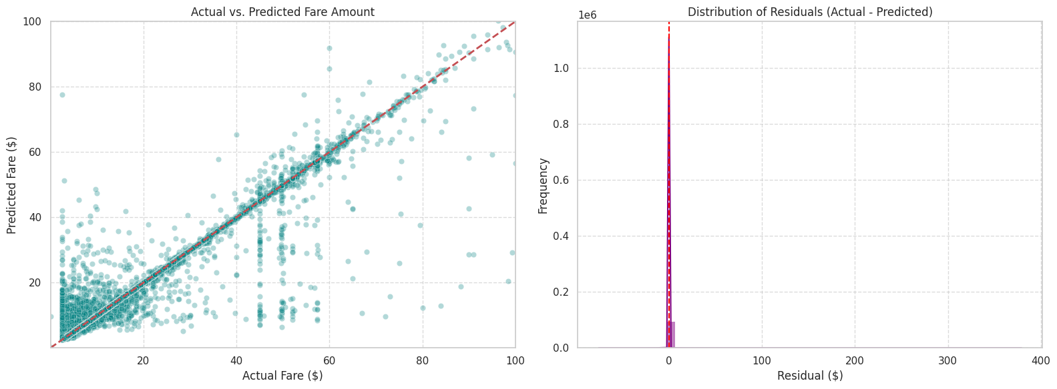
Actual vs. predicted fare
Most predictions sit on the diagonal. The errors that remain are mostly low actual fares predicted too high, plus a few large misses.
Test set

Slide 8
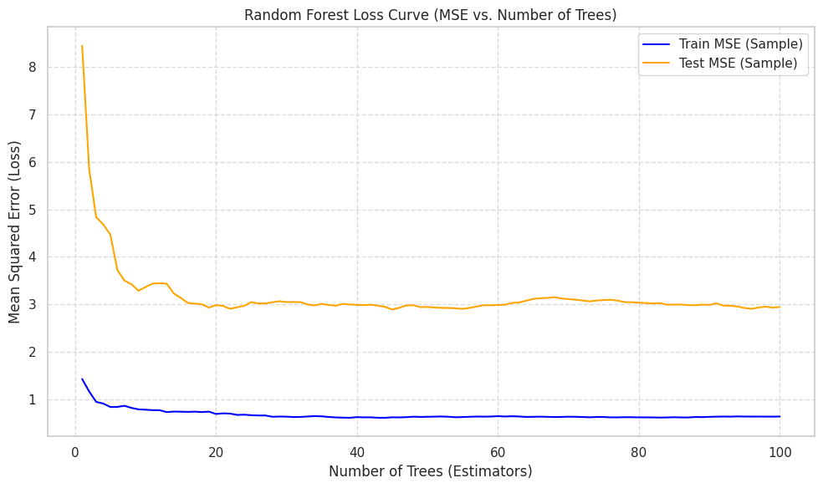
Random Forest loss curve
Test MSE flattens at about 3 after roughly 20 trees.
Train MSE stays near 0.6, so more trees do not close the gap.
Sample of 5,000 rows

Slide 9
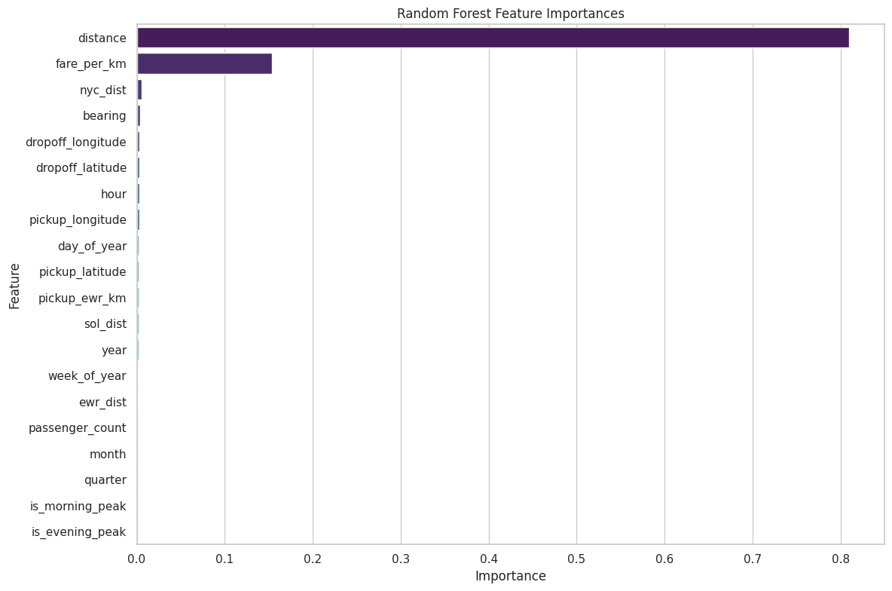
Feature importance
Distance carries 81% of the importance.
fare_per_km carries 15%, and it contains the target.
Best Random Forest, test run

Slide 10
Why those scores are still optimistic
The feature fare_per_km is fare divided by distance, so it contains the target. It still carries 15% of the importance, with distance at 81%. Winsorizing weakened the leak, but R² of 0.947 is still inflated.
Drop fare_per_km and re-run, with a simple baseline for comparison.
Fit the scaler inside a single sklearn Pipeline, after the split, and save that Pipeline with joblib.
Keep the winsorizing step: it avoids the 39% row loss that the earlier IQR rule caused.
Notes:
fare_per_km was created in the Q8 airport analysis and then flowed into the model features. Results should be re-reported after it is removed. The notebook now winsorizes instead of removing IQR outliers.

